Slide 1
College Eating Habits Survey
Benjamin Taylor

Slide 2
Details
Survey given to students at UMN
Survey consists of 7 questions
The goal of this survey is to discover how much money students spend on food each week, and what factors determine how they spend

Slide 3
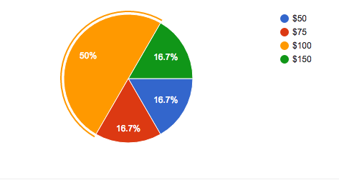
1. How much money do you spend on food each week?

Slide 4
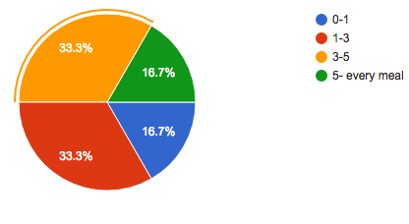
2. How many times each week do you eat out?

Slide 5
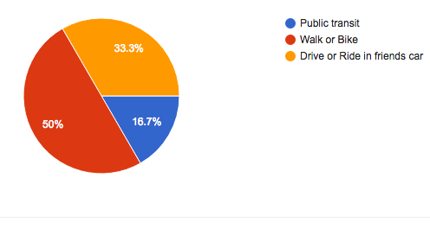
3.How do you get to the grocery store?

Slide 6
4.How would you describe your cooking abilities?
Student | Response
1 | I eat ramen a lot
2 | I like to cook sometimes
3 | Ehh
4 | I love to cook
5 | I don’t cook

Slide 7
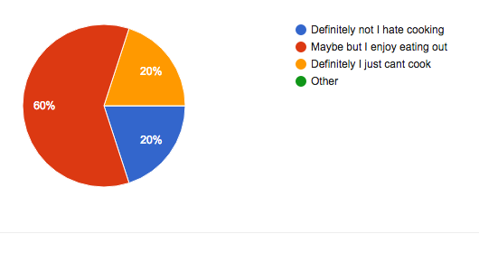
5. Would you spend less on food if you were a better cook?

Slide 8
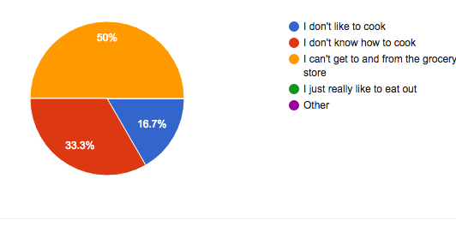
6. What plays the biggest role in the amount you eat out?

Slide 9
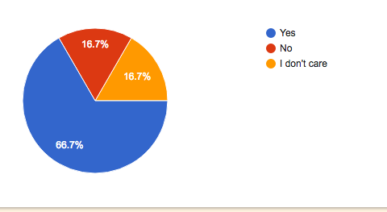
7. Do you think everyone should have basic cooking skills?

Slide 10
Conclusion
The more people eat out the more they spend on food
Ease of Transportation to and from the grocery store plays a role in how much people spend on food
Cooking skills impact how much someone eats out
People think it is important to know how to cook

